Slide 1

Water Metro Ticket and Facilities Management System
AQUA MOTUS
Mr. Jinson Devis
Assistant Professor
Department of Computer Application
Anmigha N M
INTMCA 2020 – 2025: S9
AJC20MCA-I014

Slide 2
PROJECT OVERVIEW
AQUA MOTUS is a dynamic web application designed to elevate water metro services by simplifying ticket booking and providing easy access to comprehensive service information. Users can register to browse schedules, select routes, and book tickets online, ensuring a smooth and accessible experience. The system features role-based management, where station masters oversee boat operations, scheduling, and maintenance, while admins handle registrations for boats, station masters, and new stations, as well as managing events. Through a streamlined process, AQUA MOTUS enhances user satisfaction, optimizes resource management, and supports efficient, real-time service updates across the entire water metro network.

Slide 3
The modules of the system are:
Admin
Can login to dashboard.
Add new stations.
Add boat details.
Add new events.
Register new station masters.
Can Take Report

Slide 4
Station master
Can login to dashboard.
Assign boats to specific routes and schedules.
View tickets booked by users.
Assign boat for event were payment done.
Cancel tickets have refund(80%).
Generate and view reports related to services.

Slide 5
User
Register account in aqua motus with email verification.
Can login to dashboard.
Can book the ticket for available boat schedules and Events.
View booked tickets with payment option and cancel button.
Profile View and updation.
Logout

Slide 6
Technologies used
Front End - HTML, CSS, JavaScript, Bootstrap
Backend - Python, Django Framework, DB SQLite
LITERATURE REVIEW
The Sentiment Analysis of Water Metro Passengers Review paper underscores the potential of sentiment analysis as a powerful tool to enhance service quality in water metro systems. By leveraging techniques ranging from lexicon-based methods to advanced deep learning models like LSTM, CNN, and transformer-based architectures (BERT, RoBERTa), sentiment analysis can provide meaningful insights into passenger satisfaction and areas for improvement. While the field has seen advancements, challenges remain, such as handling multilingual data, accurately interpreting domain-specific terminology, and addressing nuances like sarcasm. Future research should aim to refine these models for higher accuracy and scalability, enabling real-time, multilingual sentiment analysis that captures a more comprehensive understanding of passenger experiences.

Slide 7
SYSTEM STUDY
Existing System Drawbacks
Manual Processes: High reliance on manual ticketing and operational oversight results in inefficiencies.
Limited Accessibility & Scalability: Users must visit stations; system struggles with increasing demand.
No Real-Time Updates & Data Dependency: Passengers lack real-time info, and records are paper-based, prone to errors.
Proposed System Advantages
Enhanced User Experience & Accessibility: Users can book tickets and check schedules online, increasing satisfaction.
Operational Efficiency & Real-Time Updates: Automation reduces workload, while live data on schedules and weather improve safety.
Data Analytics & Scalability: Insights for resource allocation and modular design support future growth and expansion.

Slide 8
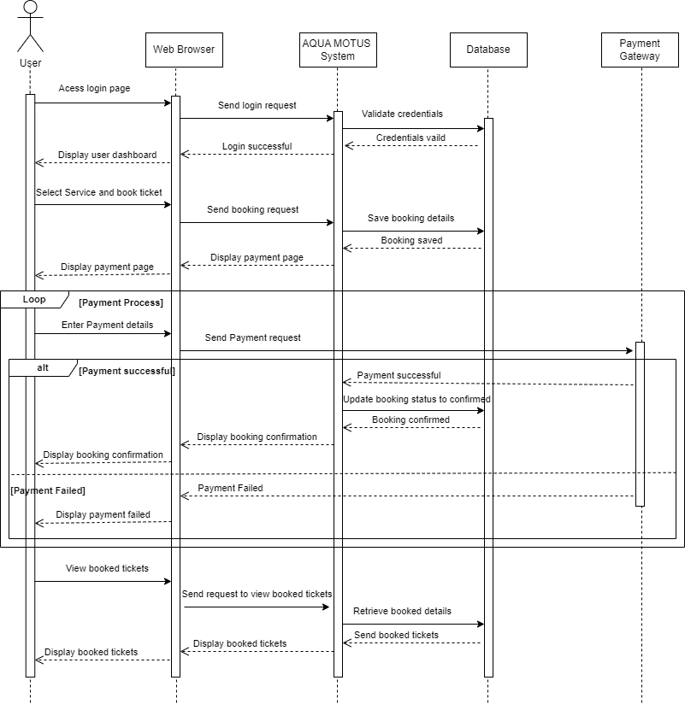
SYSTEM FLOW

Slide 9
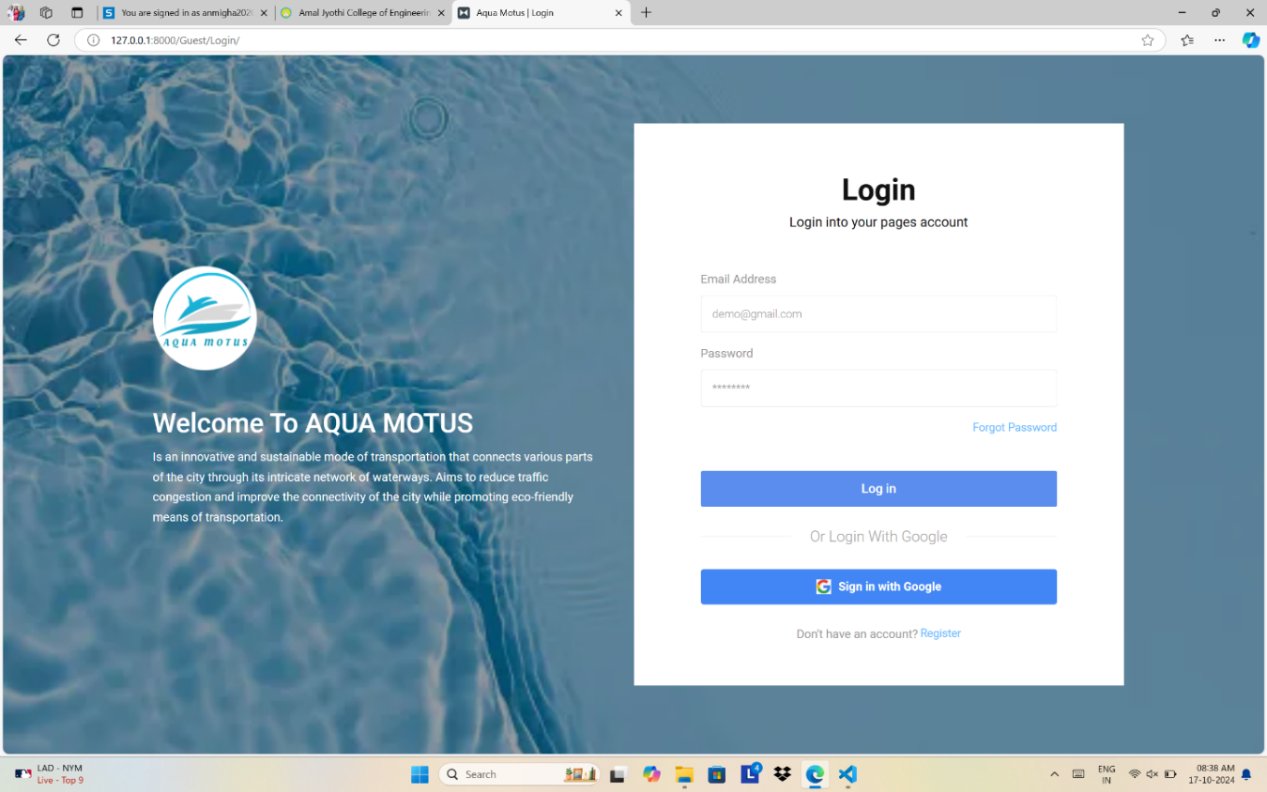
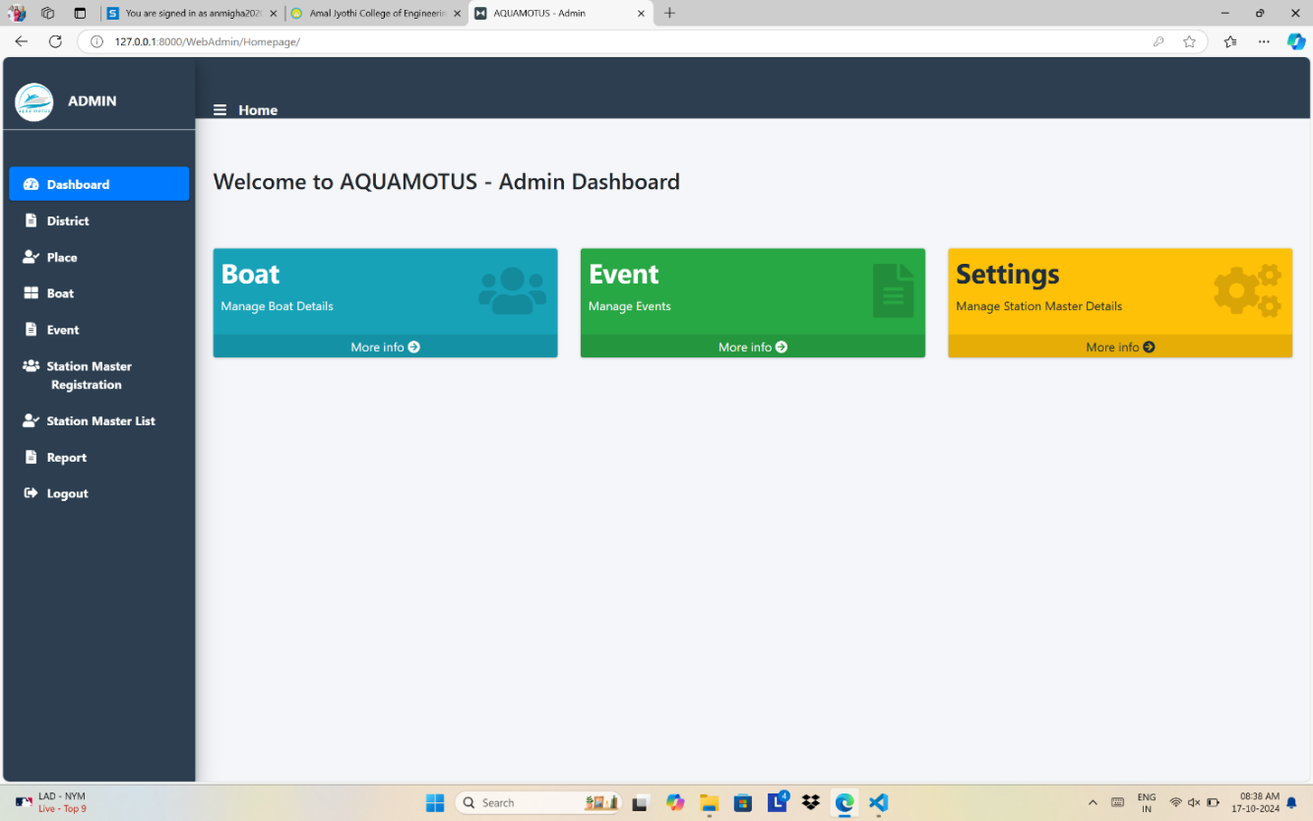
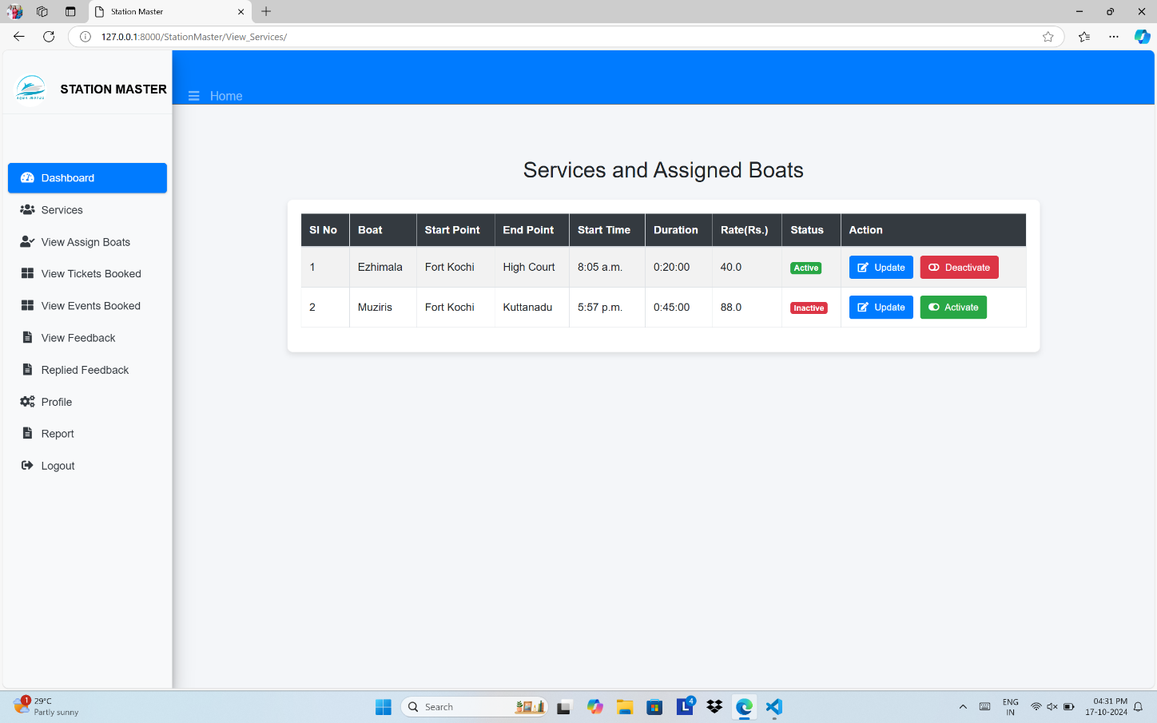
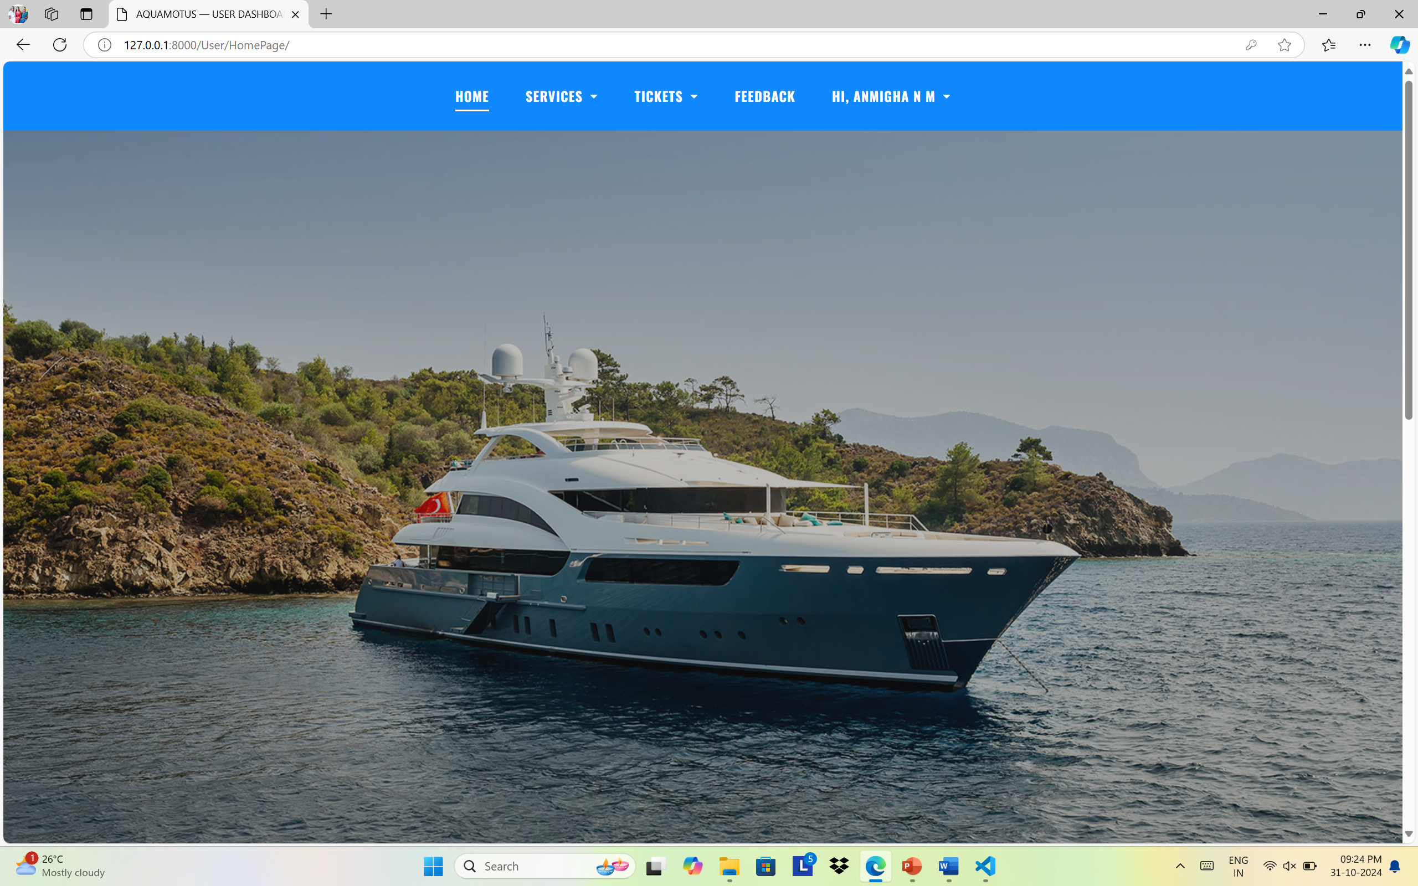
Figure 1: Login Page
Figure 2: Admin Dashboard
Figure 3: Service Assign Boat
Figure 4: User Dashboard

Slide 10
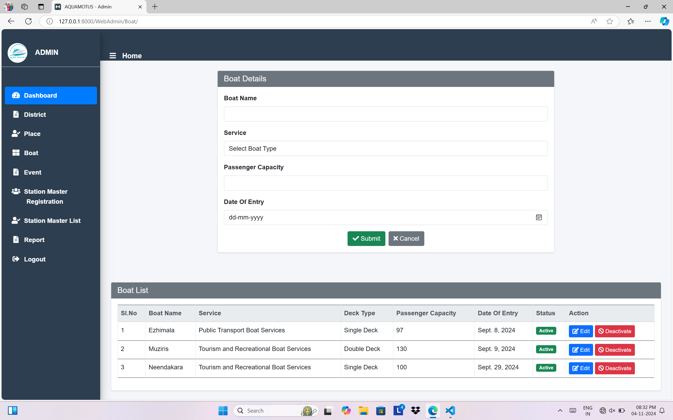
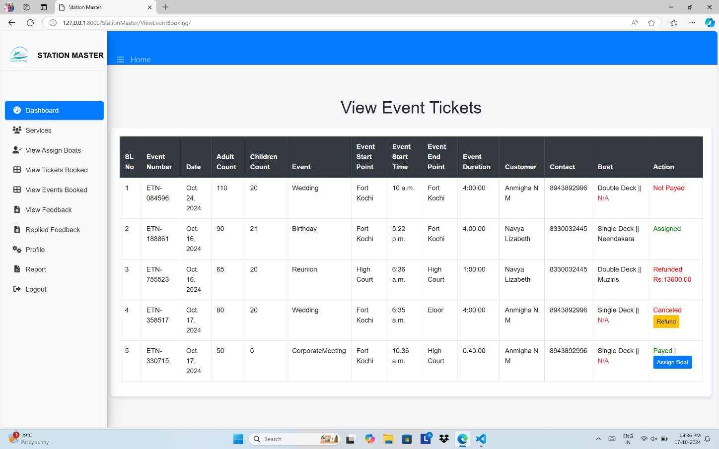
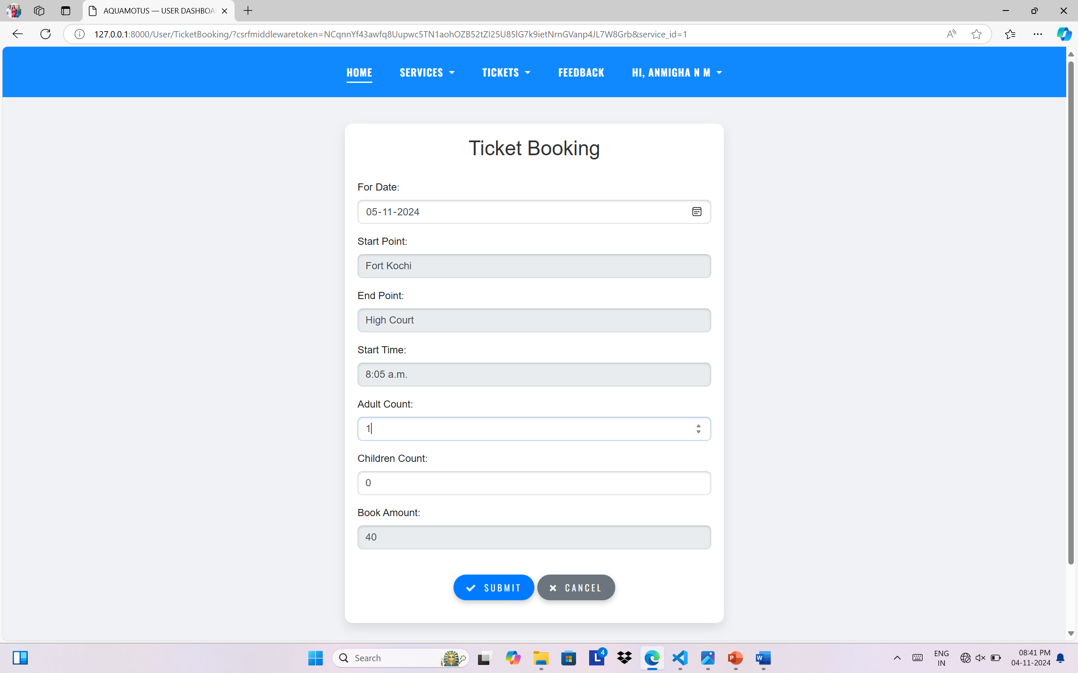
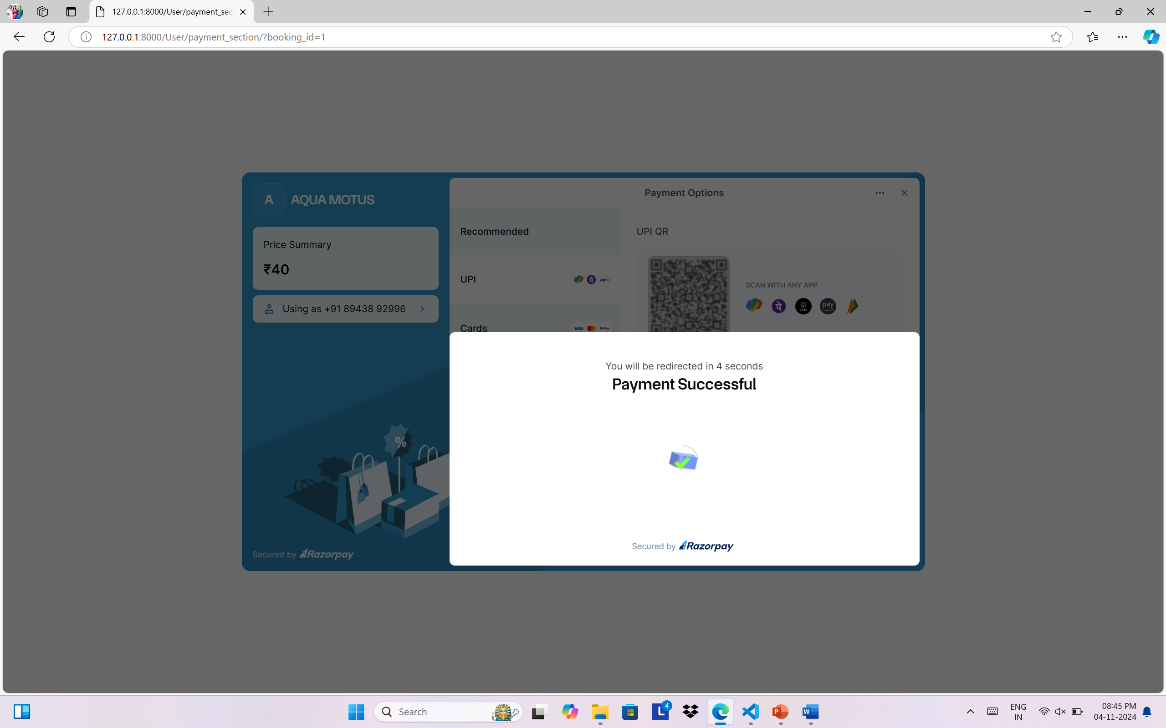
Figure 5: Add Boat
Figure 6: Event Tickets
Figure 7: Ticket Booking
Figure 8: Payment

Slide 11
CONCLUSION AND FUTURE SCOPE
Conclusion
The WaterMetro Ticketing and Facilities Management System is a transformative solution in urban transportation, enhancing user convenience, accessibility, and environmental sustainability through innovative technology.
Future Scope
Future developments include integration with smart technologies, enhanced accessibility, personalized features, and AR, all aimed at creating a seamless, connected, and data-driven transportation experience.

Slide 12
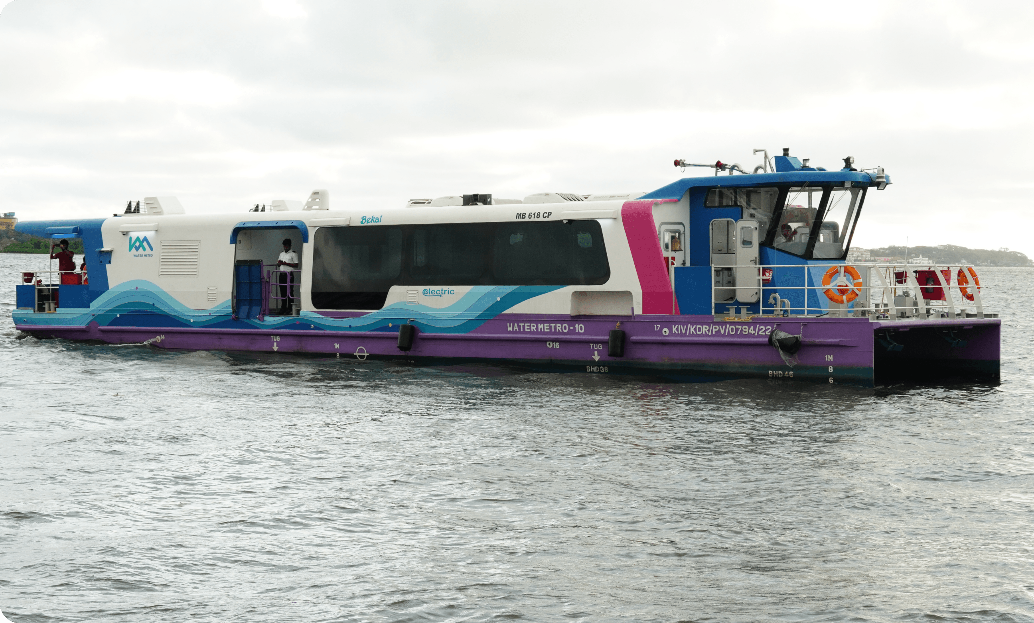
THANK YOU!

